Slide 1
HandDGCL: Two-hand 3D reconstruction based Disturbing Graph Contrastive Learning
Bing Han, Chao Yao, Xiaokun Wang, Jian Chang, Xiaojuan Ban
University of Science and Technology Beijing, Beijing 100083, China
Bournemouth University, Fern Barrow, Poole, Dorset, BH12 5BB, UK
Notes:
Hello everyone, I am XXX. It’s very great pleasure indeed for me to be able to attend this meeting. Today I would like to present our paper “HandDGCL: Two-hand 3D reconstruction based Disturbing Graph Contrastive Learning”.

Slide 2
Catalog
1 Introduction
2 Disturbing Graph Contrastive Learning
3 Experiments
4 Conclusion
Notes:
I will present our work from the following four aspects.

Slide 3
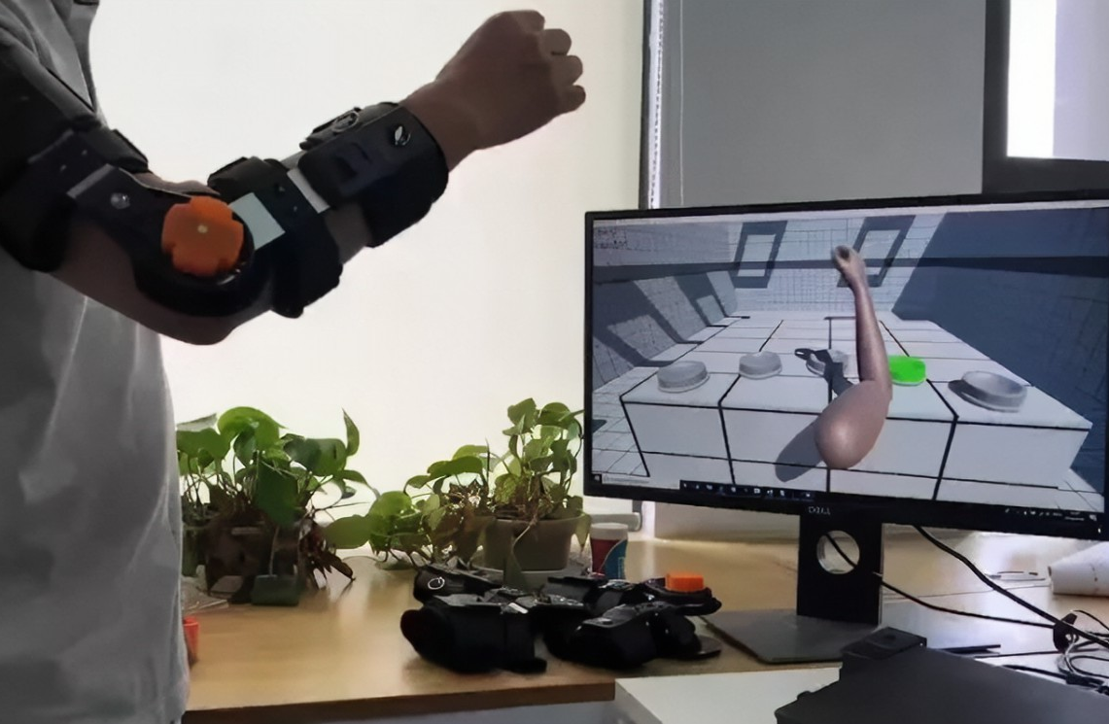
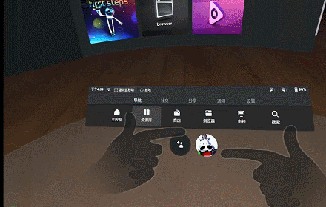
Introduction | Background
Sports rehabilitation
Sign language recognition
VR interaction
The hand is one of the main carriers for human interaction with the real world, which makes the hand equally important in the human-computer interaction of 3D scenes. The 3D reconstruction of the hand is a prerequisite for realizing a series of technologies for 3D hand-computer interaction.
Notes:
With the rapid development of emerging 3D technologies such as Virtual Reality (VR) and Augmented Reality (AR), the application scenarios of human-computer interaction are becoming increasingly complex, and the precision requirements are becoming higher. Simple interaction methods such as visual and auditory interaction can no longer meet the needs of the industry. The hand is one of the main carriers for human interaction with the real world, which makes the hand equally important in the human-computer interaction of 3D scenes. The 3D reconstruction of the hand is a prerequisite for realizing a series of technologies for 3D hand-computer interaction.

Slide 4
Introduction | GCN based Hand Reconstruction
[1]Defferrard M, Bresson X, Vandergheynst P. Convolutional neural networks on graphs with fast localized spectral filtering[J]. Advances in neural information processing systems, 2016, 29.
[2] Ge L , Ren Z , Li Y , et al. 3D Hand Shape and Pose Estimation from a Single RGB Image[J]. 2019 IEEE/CVF Conference on Computer Vision and Pattern Recognition (CVPR), 2019.
Notes:
As is widely known, GCN performs exceptionally well for data structures that exhibit graph-like relationships. The article authored by Ge et al. is one of the earliest studies to incorporate GCN into research on 3D hand reconstruction. The study reveals that the spatial surface topology of the hand approximates a graph-like data structure, making it ideal for feature decoding using GCN. In this figure, the hand's spatial structure ranges from coarse to fine, resulting in high-precision 3D reconstruction of the hand mesh. This forms the cornerstone of the work presented in this article.

Slide 5
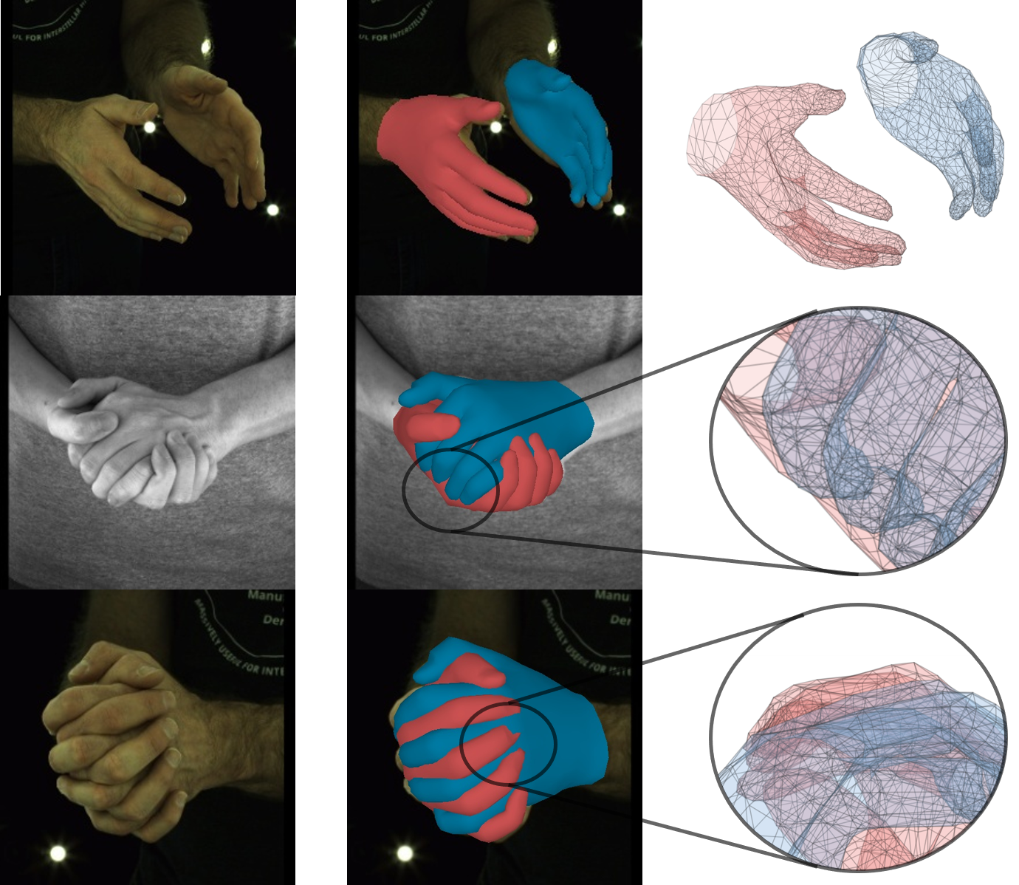
Introduction | Challenge
non-interactive
correct & appropriate
interactive
severe mutual occlusion &
enormous diversity
geometric conflicts &
incorrect relative position
interactive
Notes:
However, relying solely on GCN is insufficient for achieving high-quality 3D reconstruction of hands in complex scenarios, especially in situations involving hand-to-hand interaction, which presents more severe self-occlusion and increased complexity. In the figure presented in our experiment, we observe significant geometric conflicts and misalignment where the hands interact, which is highly undesirable. Addressing the problem of hand-to-hand interaction in such scenarios is the focus of this study.

Slide 6
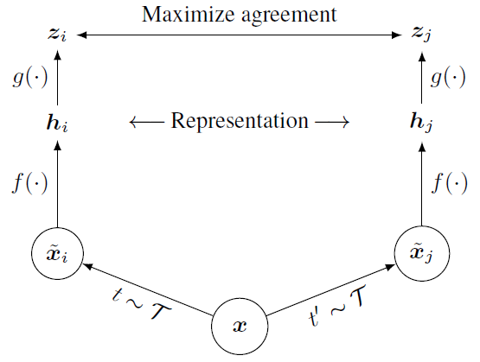
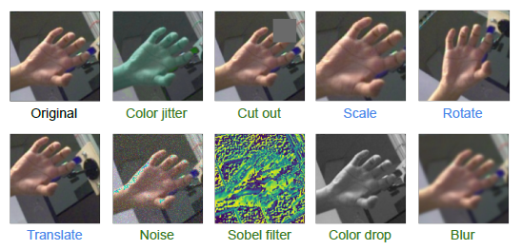
Disturbing Graph Contrastive Learning | Prerequisite
[3] Chen T , Kornblith S , Norouzi M , et al. A Simple Framework for Contrastive Learning of Visual Representations[J]. 2020.
[4] Spurr A , Dahiya A , Zhang X , et al. Self-Supervised 3D Hand Pose Estimation from monocular RGB via Contrastive Learning[J]. 2021.
Notes:
According to the classic theory of contrastive learning, when some form of disturbance is applied to raw data and does not alter the intrinsic properties of the data, multiple disturbed objects can still be grouped into the same category as they are homogenous. Therefore, when training a model to minimize the distance between these disturbed objects, we essentially force the model to learn the intrinsic properties of the data. This amazing idea of self-supervised learning has already been applied in the field of hand pose estimation with promising results. The figure in the lower right corner displays ten different forms of disturbance.

Slide 7
Disturbing Graph Contrastive Learning | Explicit Graph Disturbing
①Add Random Noise
②Random Mask
③Add Random Edge
$$A_{1}=\left[\begin{matrix}\begin{matrix}0 & 2 \\ 2 & 0\end{matrix} & \begin{matrix}2 & 4 \\ 8 & 1\end{matrix} \\ \begin{matrix}2 & 8 \\ 4 & 1\end{matrix} & \begin{matrix}0 & 5 \\ 5 & 0\end{matrix}\end{matrix}\right]$$
④Symmetrical Flip
$$A_{1}=\left[\begin{matrix}\begin{matrix}0 & 1 \\ 1 & 0\end{matrix} & \begin{matrix}2 & 3 \\ 8 & 0\end{matrix} \\ \begin{matrix}2 & 8 \\ 3 & 0\end{matrix} & \begin{matrix}0 & 5 \\ 5 & 0\end{matrix}\end{matrix}\right]$$
$$A=\left[\begin{matrix}\begin{matrix}0 & 1 \\ 1 & 0\end{matrix} & \begin{matrix}2 & 3 \\ 8 & 0\end{matrix} \\ \begin{matrix}2 & 8 \\ 3 & 0\end{matrix} & \begin{matrix}0 & 5 \\ 5 & 0\end{matrix}\end{matrix}\right]$$
$$A=\left[\begin{matrix}\begin{matrix}0 & 1 \\ 1 & 0\end{matrix} & \begin{matrix}2 & 3 \\ 8 & 0\end{matrix} \\ \begin{matrix}2 & 8 \\ 3 & 0\end{matrix} & \begin{matrix}0 & 5 \\ 5 & 0\end{matrix}\end{matrix}\right]$$
$$A_{2}=\left[\begin{matrix}\begin{matrix}0 & 1 \\ 1 & 0\end{matrix} & \begin{matrix}3 & 3 \\ 9 & 1\end{matrix} \\ \begin{matrix}3 & 9 \\ 3 & 1\end{matrix} & \begin{matrix}0 & 5 \\ 5 & 0\end{matrix}\end{matrix}\right]$$
$$A_{2}=\left[\begin{matrix}\begin{matrix}0 & 5 \\ 5 & 0\end{matrix} & \begin{matrix}0 & 3 \\ 8 & 2\end{matrix} \\ \begin{matrix}0 & 8 \\ 3 & 2\end{matrix} & \begin{matrix}0 & 1 \\ 1 & 0\end{matrix}\end{matrix}\right]$$
Notes:
From the previous figure, it is evident that the disturbance methods used in image-based contrastive learning are mostly simple pixel-level operations such as offset, blur, and distortion. Can we disturb the data at the feature level? Graph contrastive learning provides solutions to this problem. The first disturbance involves adding Gaussian noise directly to the graph features, the second disturbance randomly masks some channels of each node, the third disturbance adds random integers to the adjacency matrix of the graph, and the fourth disturbance involves flipping the adjacency matrix symmetrically. The first two methods are relatively straightforward, while the latter two utilize the properties of graphs. These were our initial experimental settings. However, through experimentation, we found that no individual disturbance method or combination thereof could improve the model's performance. So, where did the problem lie?

Slide 8
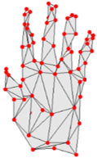
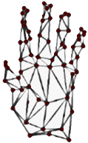
Disturbing Graph Contrastive Learning | How to construct graph disturbance
Disturbance
Graph Feature
63 × 512
Generative Network
MLP
Loss
Make sure the disturbance would not change the pose information!
Notes:
Let us revisit the contrastive learning paradigm, where a prerequisite condition is disturbance that does not alter the intrinsic properties of the data. The feature-level disturbance methods we mentioned earlier suffer from a fatal flaw: they cannot guarantee consistency in intrinsic properties, which is the reason for the model's poor performance. Is it possible to ensure this consistency through some method? Yes, we innovatively generate transformations on the original graph features, which we consider as feature disturbance. We then add an MLP to the transformed features and use the deviation between the output of MLP and the hand pose label to form a loss. This way, we force the model to learn a generative network through supervised learning, and the transformed data processed by this network does not lose the hand pose information, which is an intrinsic property we aim to preserve. Of course, this supervision is an additional subtask in an end-to-end training framework and does not affect the original model inference process.

Slide 9
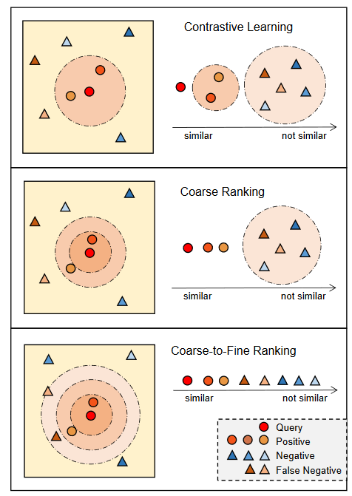
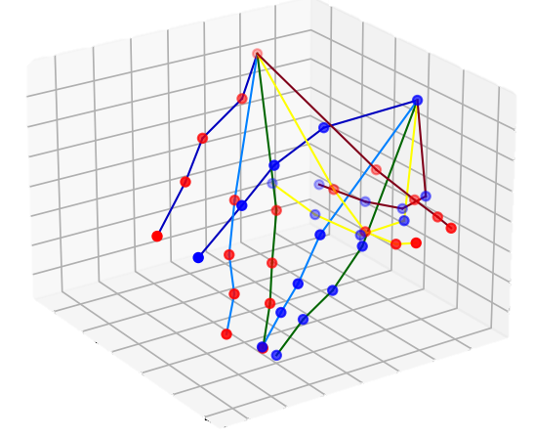
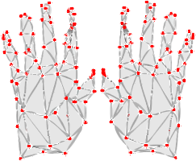
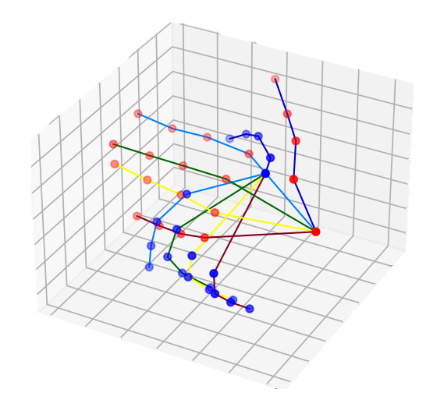
Disturbing Graph Contrastive Learning | Similarity Distinguish
$$J_{k}$$
$$G_{k}$$
Prediction
Similarity Distinguish
GCN result
$$J_{m}$$
$$G_{m}$$
From the same batch
From the same batch
Similarity Distinguish
Feature-pose Pool
[5] Zhao P, Pan Y, Li X, et al. Coarse-to-Fine Contrastive Learning on Graphs[J]. IEEE Transactions on Neural Networks and Learning Systems, 2023.
Notes:
To address the issue of unstable loss during model training, we have proposed an Similarity Distinguish method. By comparing the similarity of hand poses, we refine the division between positive and negative sample pairs, making the contrastive learning training more stable and effective. This method is inspired by the coarse-to-fine idea introduced by Zhao et al.

Slide 10
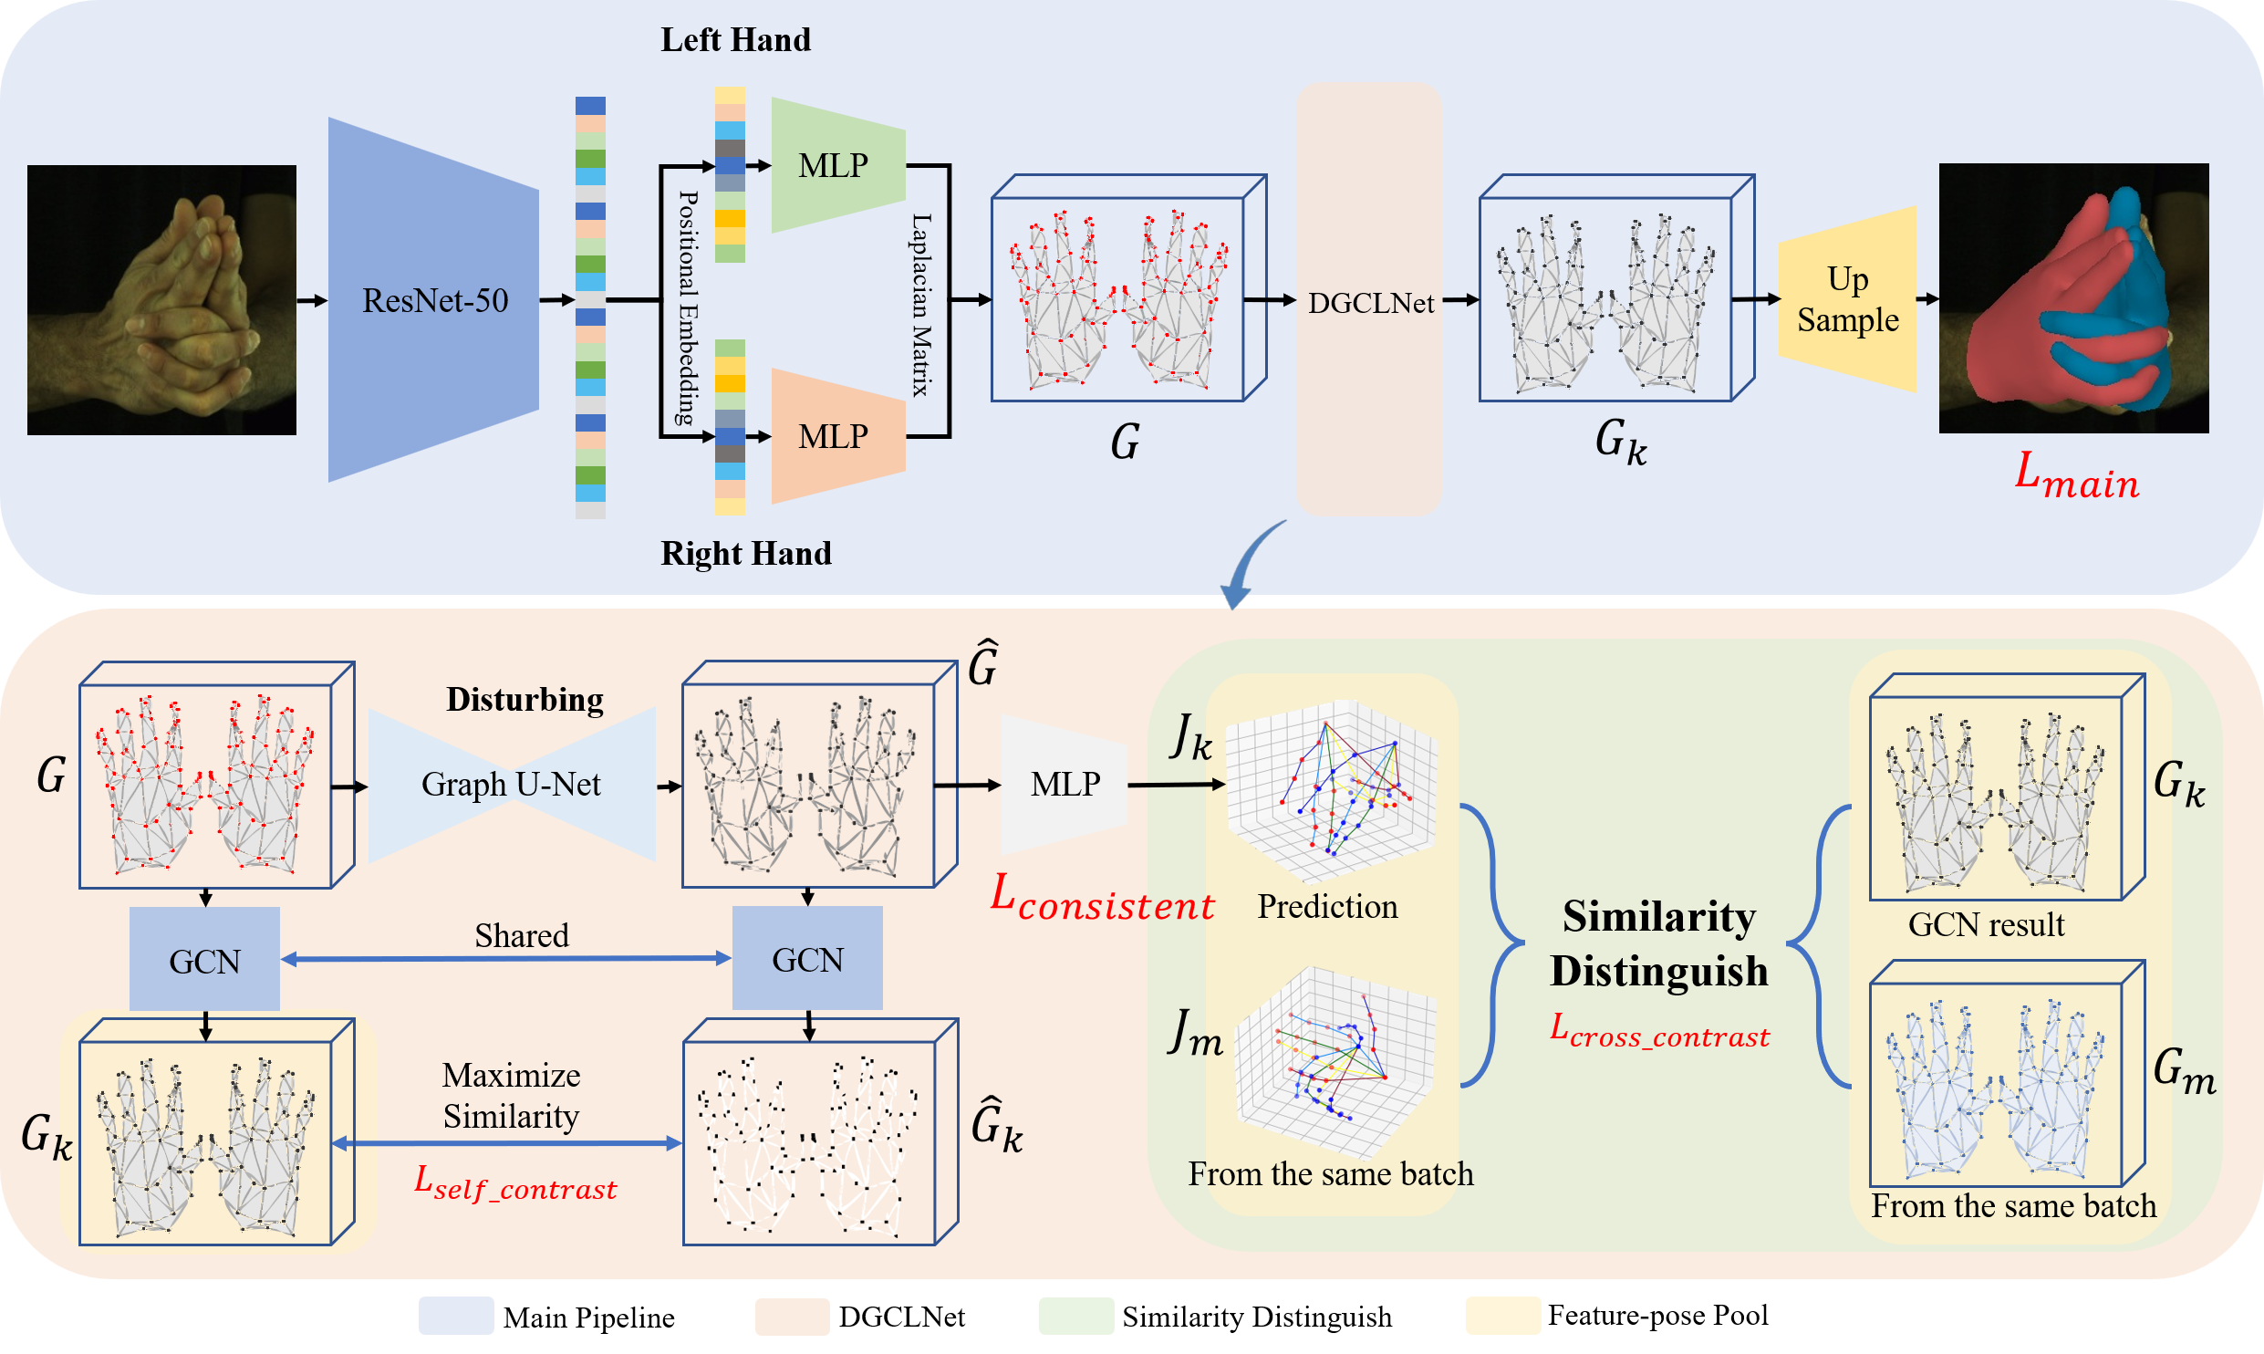
Disturbing Graph Contrastive Learning | Model Structure
Notes:
Now we can get the whole model structure.
The top section depicts the main flow of the model, while the bottom section shows the computational process of DGCLNet, where the green-colored area represents the Similarity Distinguish module.
Given an RGB image, our model uses ResNet-50 for feature extraction and then the feature is divided into left hand and right hand via positional embedding.
Both of the hand feature are further processed by two independent MLP layers, and build up the graph feature using the knowledge of Laplacian matrix.
Next our DGCLNet makes disturbance by regenerating the graph feature through a graph u-net.
The pair of graph feature is passed through the same GCN, and the similarity between them is maximized.
Finally the graph feature of original branch is thrown into the up sample layer to get the position of 778 vertices in standard MANO way.

Slide 11
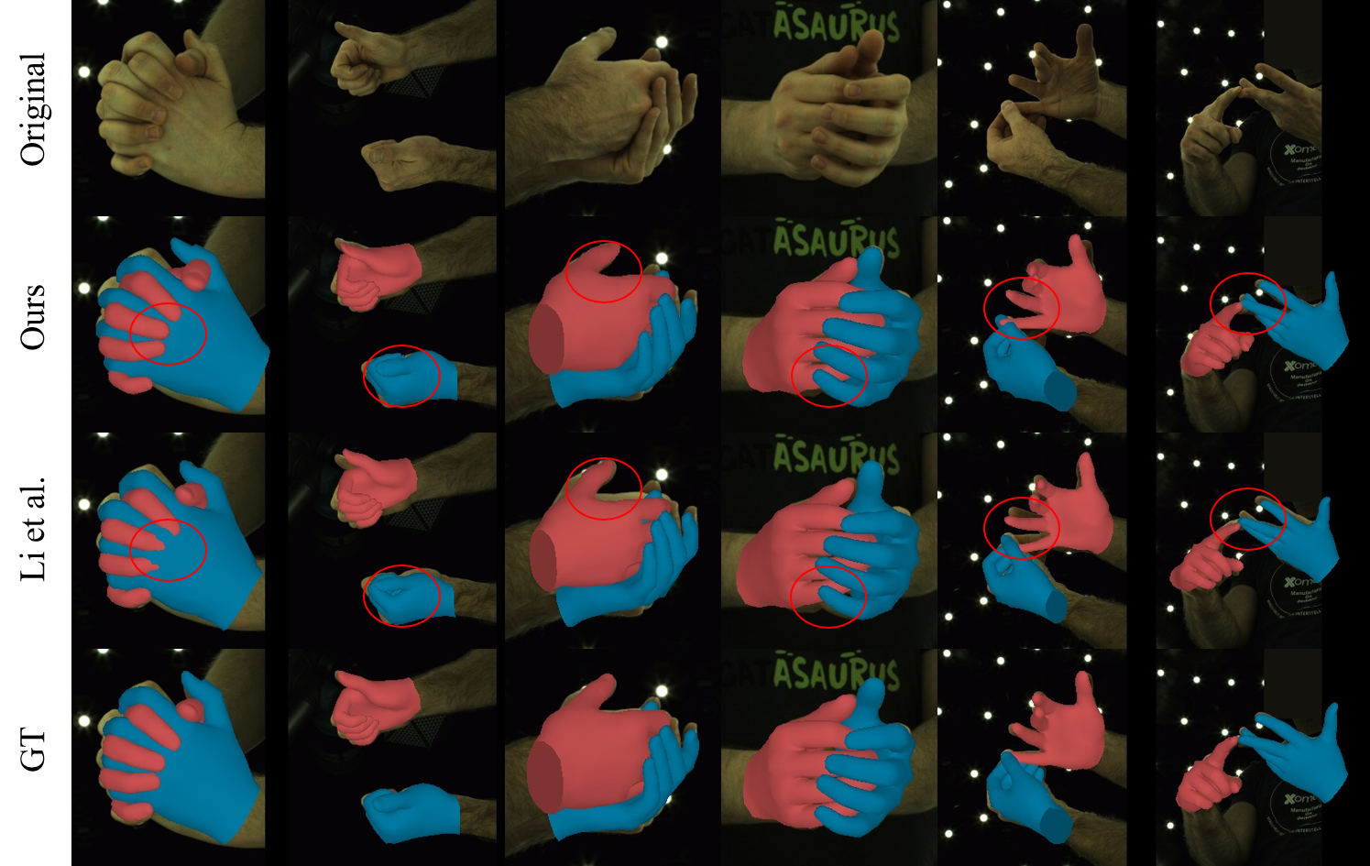
Experiments | Qualitative Results
Notes:
Our model demonstrates the ability to successfully capture and reconstruct complex interactions of two hands.
The first column of our qualitative results indicates that our model has fewer collisions.
The results of Columns 2 and 4 indicate that the performance of our model is superior when the two hand meshes are close to each other, yet not making contact.
Columns 3 and 5 indicate that our model results in a better matching between the hand mesh and the hand mask, which implies enhanced location accuracy.
The last column of our results highlights that our model has a deep understanding of hand occlusion, and is able to reconstruct detailed hand poses competently.

Slide 12
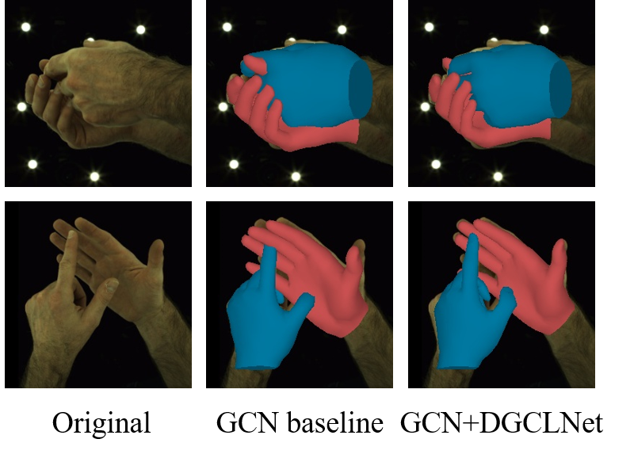
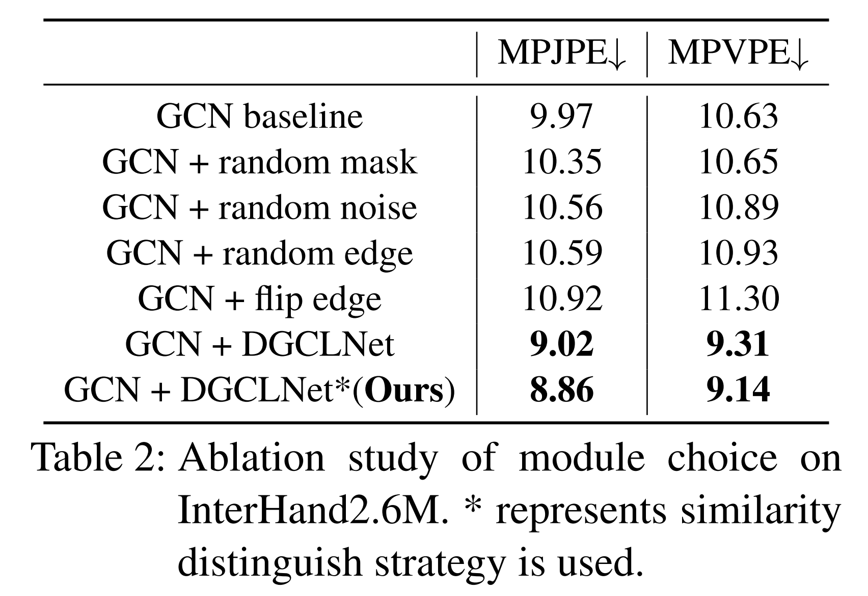
Experiments | Ablation Study
Notes:
We tested the contrastive module with both EGD and DGCLNet based on GCN baseline. The result is shown in Tab.2.
As discussed before, explicit graph disturbing methods may lead to a loss of consistency for graph features which accounts for their poor performance.
We see that DGCLNet module reduces the error by 1.6 mm.
Thanks to the disturbance network, the model is able to learn from slightly different graph features without compromising the consistency of the pose and feature.
The qualitative results are given in the left.
It is clear that our DGCLNet module improves the baseline by reducing collisions, resulting in a hand mesh that is more realistic and lifelike.
Besides, the overlap of hand mask is more precise, which indicates the higher performance in visual comprehension.

Slide 13
Conclusion
In conclusion, this paper introduces a novel graph contrastive method for two-hands 3D reconstruction from a single image.
To deal with challenges such as hand-hand occlusion and the homogeneous and self-similar appearance of hands, we introduce novel graph contrastive method to enhance model ability to rebuild 3D topographical structure. More specifically, an explicit graph disturbing is tried but does not perform well due to its inconsistency. To resolve that issue, a DGCLNet was proposed to force the features of disturbed data to remain consistent.
A similarity distinguish strategy was further used instead of the discrete settings which made the model more robust and yielded better results.
Moreover, a multi-term loss is designed to balance the relation among the hand pose, the visual scale and the viewpoint position.
Experiments validate the superiority of our proposed method over the state-of-the-art methods.

Slide 14
Thanks for Listening!

