Slide 1
GestureTeach: A Gesture Guided online TeachingInteractive Model
Hongjun Liu, Chao Yao, Yalan Zhang, Xiaojuan Ban
University of Science and Technology Beijing, Beijing 100083, China
Bournemouth University, Fern Barrow, Poole, Dorset, BH12 5BB, UK
Notes:
Hello everyone, I am Hongjun Liu. It’s very great pleasure indeed for me to be able to attend this meeting. Today I would like to present our paper “GestureTeach: A Gesture Guided online TeachingInteractive Model”.

Slide 2
Catalog
1 Introduction
2 Proposed Method
3 Experiments
4 Conclusion
Notes:
I will present our work from the following four aspects.

Slide 3
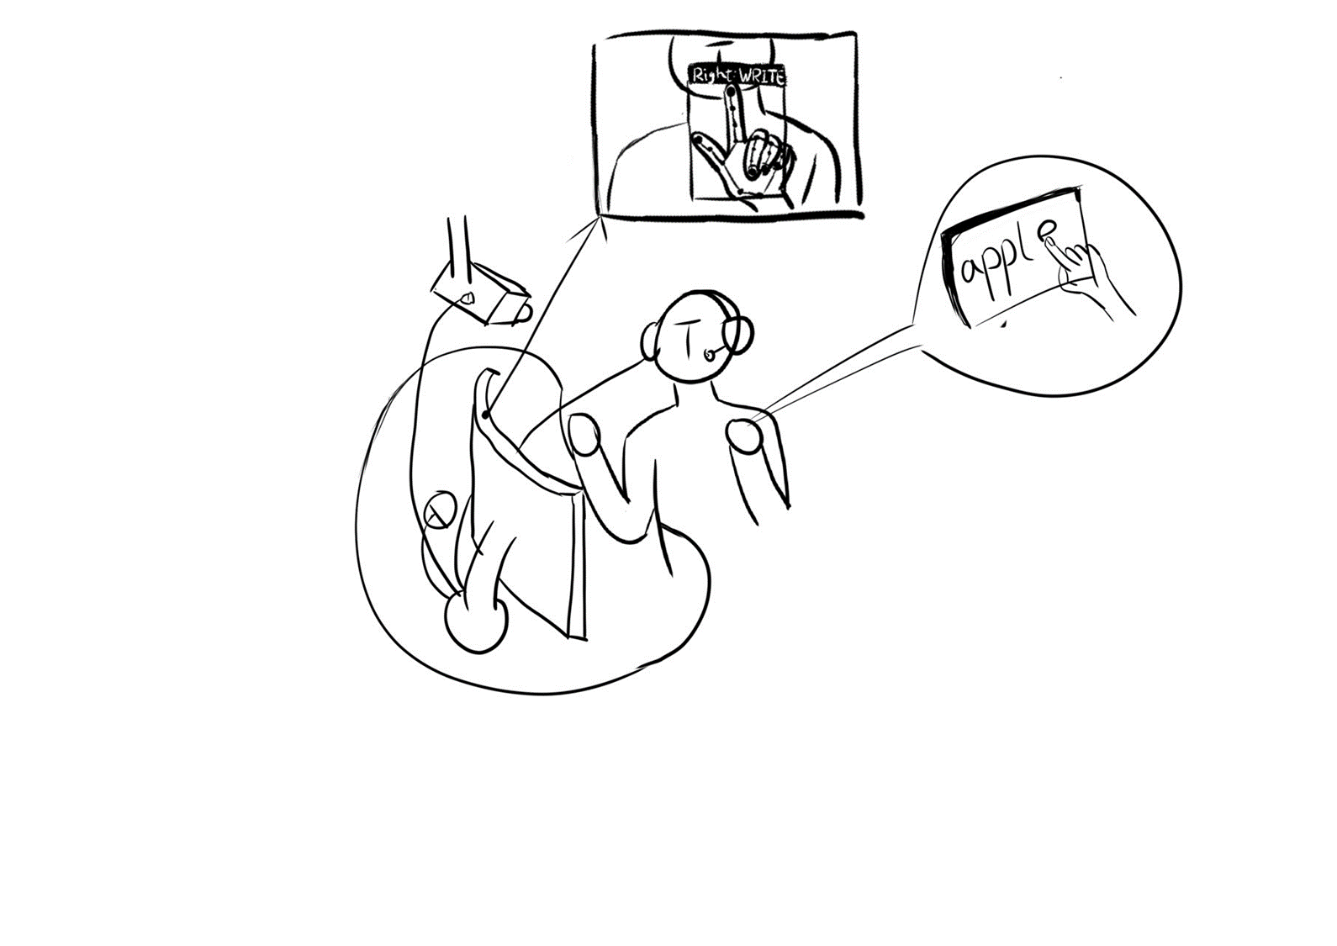
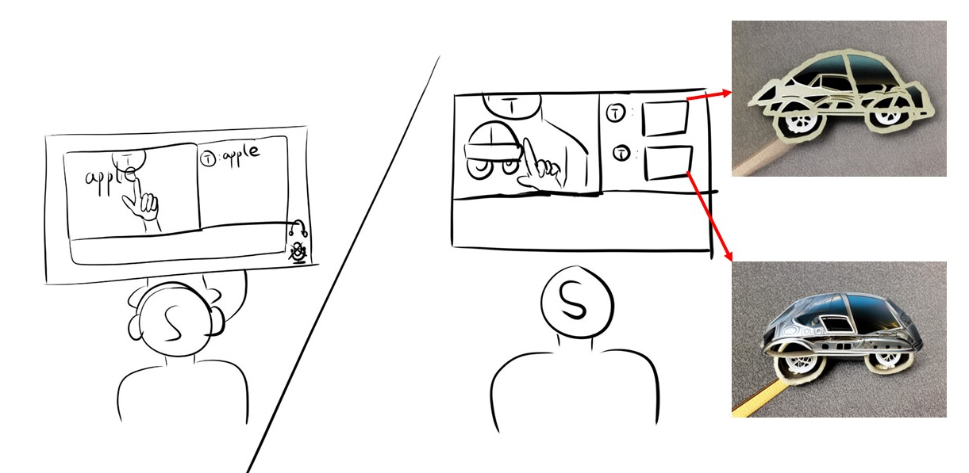
Introduction | Background
STUDENT CLIENT
TEACHER CLIENT
User Intention Understanding
Human-machine Friendly Presentation
Teachers make use of predesigned gestures captured by regular cameras to facilitate the process of handwriting, such as forming the word ’apple’ or creating arbitrary sketches. Subsequently, the corresponding animations are intelligently generated, providing a user-friendly teaching method for both teachers and students.
Notes:
In recent years, the importance of online education has become increasingly prominent, ledding to a surge in online teaching, with 90% of it being a simple classroom relocation. However, 80% of college and university teachers have never participated in online teaching through live broadcasts, leading to challenges in adapting to this new format. To tackle the challenge of the limitations and drawbacks of existing online teaching methods, we propose GestureTeach, a novel pedagogical paradigm that enables high freedom handwriting and vivid animation generation.

Slide 4
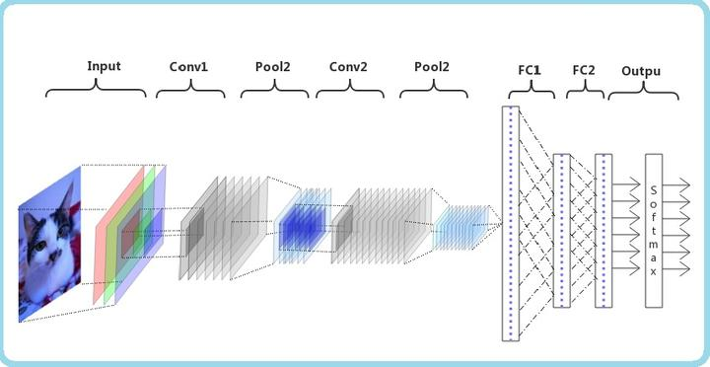
Introduction | Current Method
[1] Xing Yingxin, Li Jinghua, Wang Lichun, and Kong Dehui. A robust hand gesturerecognition method via convolutional neural network. In 2016 6th international conference on digital home (ICDH), pages 64– 67. IEEE, 2016. 3
[2] Oyebade K Oyedotun and Adnan Khashman. Deep learning in vision-based static hand gesture recognition. Neural Computing and Applications, 28(12):3941–3951, 2017. 3
Notes:
Most approaches recognize the gestures by applying machine-learning techniques to a set of relevant features extracted from the depth data. In silhouette and cell occupancy features are used to build a shape descriptor that is then fedto a classifier based on action graphs. However, machine-learning based methods are not robust for the hand recognition in the wild. With the rapid growth of computer vision and deep learning, the CNN model has become a popular choice for features extraction and classification tasks.
For example, in [1] a robust method was proposed for hand gesture recognition based on a modified convolutional neural network and prepossessed edge data. As for [2], deeplearning to the problem of hand gesture recognition was applied for 24 hand gestures, in which an end-to-end convolutional neural network is proposed to recognize American sign language.

Slide 5
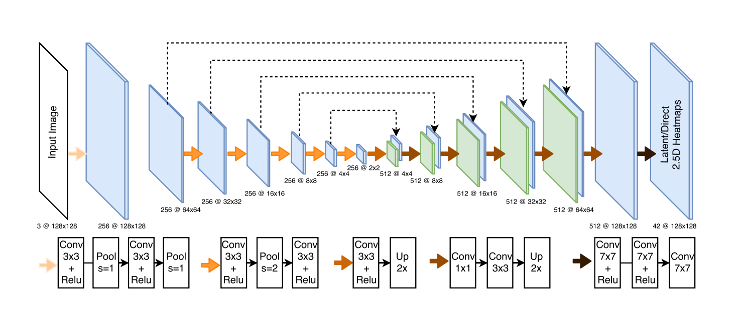
Introduction | Challenge
They are not lightweight！
[3] Tomas Simon, Hanbyul Joo, Iain Matthews, and Yaser Sheikh. Hand keypoint detection in single images using multiview bootstrappingstacked hourglass approach. In Proceedings of the IEEE conference on Computer Vision and Pattern Recognition, pages 1145–1153, 2017. 3
[4] Umar Iqbal, Pavlo Molchanov, Thomas Breuel Juergen Gall, and Jan Kautz. Hand pose estimation via latent 2.5 d heatmap regression. In Proceedings of the European Conference on Computer Vision (ECCV), pages 118–134, 2018. 3
Notes:
However, end-to-end networks are not enough for more elaborate tasks. To solve above problems inherent to end-to end recognition methods, there are researchers [3] first presenting an approach that uses a multicamera system to train fine-grained detectors for keypoints that are prone to occlusion, such as the joints of a hand. This method was widely used to train a hand keypoint detector for single images and the resulting keypoint detector runs in realtime on RGB images. In [4], a new method was proposed for 3D hand pose estimation from a monocular image through a novel 2.5D pose representation. However, these models generally perform better but are larger and computationally demanding simultaneously, thus, are not lightweight enough to run real-time on commodity mobile devices.

Slide 6
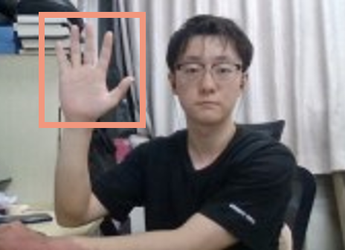
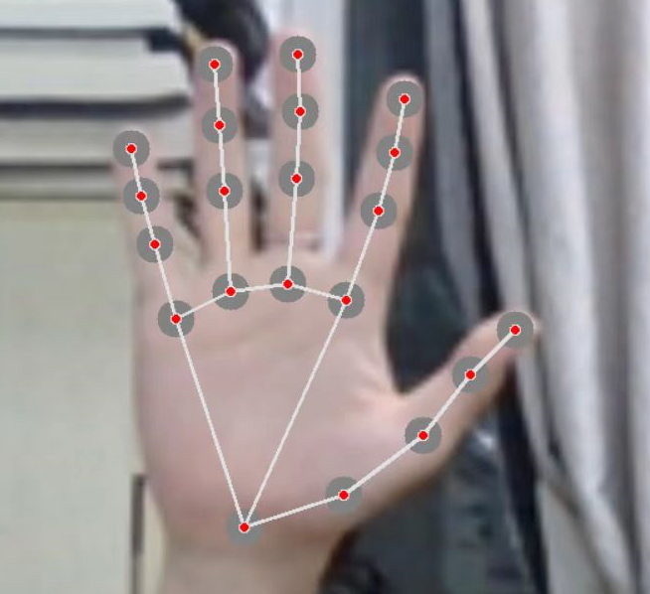
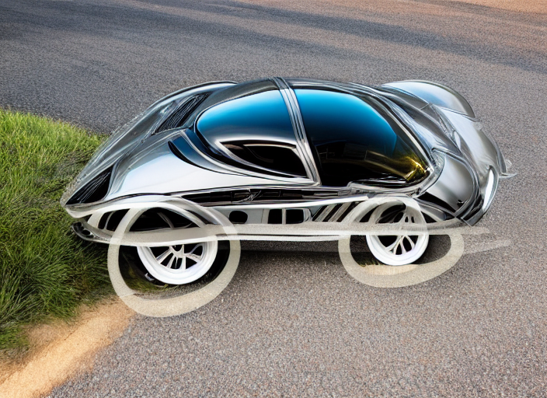
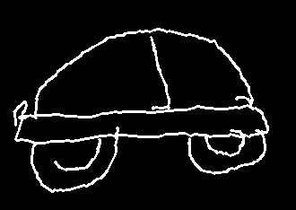
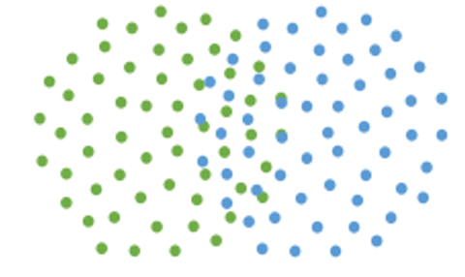
Proposed Method | GestureTeach System Overview
Gesture Recognition Module M-1
Palm Detection Block
Stable Diffusion Encoder/Decoder
Down-Sampling
Landmark Regression
Block
Character Recognition Block
Up-Sampling
$$PDB_{M}$$
$$PDB_{M−1}$$
$${PR}_{M−1}$$
S
Sketch Gesture Instruction
H
Handwrite Gesture
Instruction
Summation
$$Previous frame$$
$$IF_{M−1}$$
$$LRB_{M−1}$$
$$LRB_{M}$$
Image Animation Generation Module
$$L_{M−1}$$
Gaussian
Noise
…
…
$$SDE_{1}$$
$$SDE_{n}$$
$$SDD_{1}$$
$$SDD_{n}$$
Gesture Recognition Module M
…
…
$$SDE_{1}$$
$$SDE_{t}$$
Sketch
$$PDB_{M}$$
S
$$Current frame$$
$${PR}_{M}$$
$$IF_{M}$$
$$LRB_{M}$$
H
$$L_{M}$$
$$CRB$$
“JUMP”
$$Draw Points$$
Notes:
GestureTeach commences by downsampling the input frame to reduce the calculation scale and processing time. The downscaled Input Frame is then fed through the Palm Detection Block (PDB) to detect the teacher’s palm and the Landmark Regression Block (LRB) to recognise their gestures. With the aid of the system’s interactive suggestive cues, teachers can effortlessly facilitate the handwriting process, with the results saved as points. Following the completion of the handwriting process, teachers utilise gestures classified by the Gesture Recognition Module (GRM) to indicate different animation types. Text type sketches are subsequently inputted into the Character Recognition Block (CRB), which outputs printed-font text. While in the intelligent generation of animations, GestureTeach employs an encoder-decoder architecture, comprising the Stable Diffusion Encoder (SDE) and Stable Diffusion Decoder (SDD). The image-type sketches are inputted into the shared-weight SDEs and upsampled, serving as control conditions before being concatenated with the diffusion process features. The generated animations are presented to students in a user-friendly manner via the Animation Generation Module.

Slide 7
Proposed Method | Gesture Recognition Module
$$Previous$$
$$Frame{ X}_{t−1}$$
$$classifier$$
$${\hat{C}}_{t−1}$$
Landmark Regression Block
S
or
H
Encoder
Instructions
$${ X}_{t}$$
$$handwrite$$
$${\hat{C}}_{t}$$
Cropped
Image $\hat{C}$
Decoder
Landmarks$l_{1}, …,l_{21}$
Keypoints
Heatmap $F$
$$Draw Points$$
Palm Detection Block
$$Current$$
$$Frame{ X}_{t}$$
$$Classifier:Conv:3×3$$
$$P^{r}$$
h
$$Classifier:Conv:3×3$$
$$P^{r+1}$$
$$Classifier:Conv:3×3$$
$$P^{r+2}$$
P
Cropped
Image ${\hat{C}}_{t}$
$$Encoder Ω$$
$Multi Branch Detector$ Φ
Notes:
As shown in Figure , for the need of smooth and real-time handwriting, GestureTeach directly feed the palm region detected in the previous frame Xt−1 into the LRB. the existence Eˆ calculated later is false, indicating the non-existence of hands, the PDB will recalculate the palm position based on the image input of the current frame, which simultaneously means that the hand tracking fails. The idea behind this pipeline is to reduce the time consumption for hand region localization, thus saving computational resources.GestureTeach incorporates hand-drawn sketches as control conditions into the generation model, achieving semantic-based animation generation based on the sketches.

Slide 8
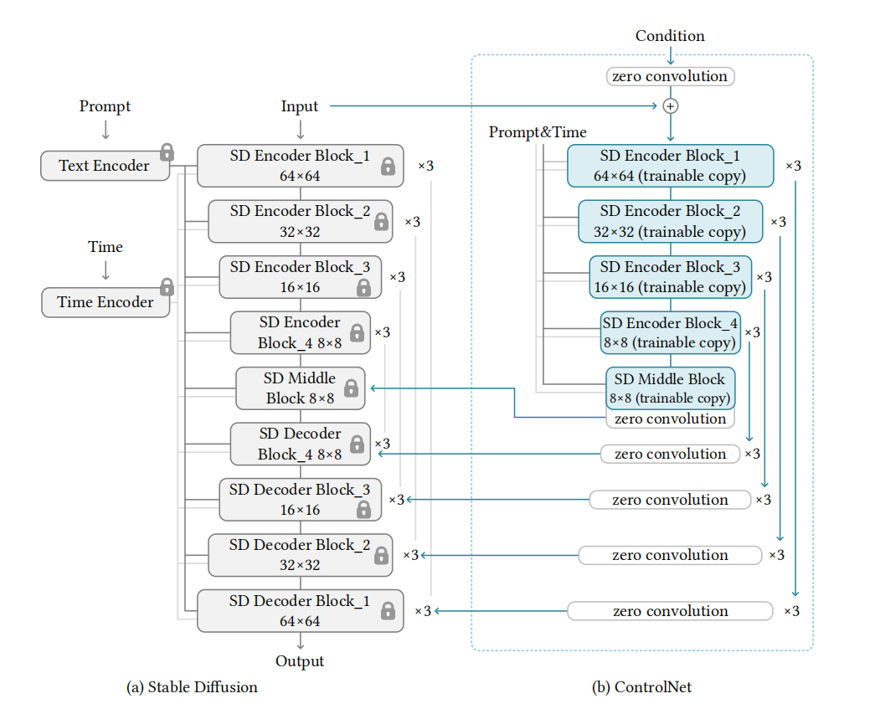
Proposed Method | Animation Generation Module
Animation Generation Module
Gaussian
Noise
…
…
$$SDE_{1}$$
$$SDE_{n}$$
$$SDD_{1}$$
$$SDD_{n}$$
…
…
$$SDE_{1}$$
$$SDE_{t}$$
Sketch
Notes:
In the context of online teaching, the interaction between teachers and students mainly comes from the blackboard, which highlights the importance of the Animation Generation Module (AGM). For image animation generation, we present a novel architecture to sketching and 2D animation generation by capturing the trajectory of the user’s index finger. The AGM uses stable diffusion techniques[18] to generate high-quality animations from the captured sketches. The stable diffusion algorithm combines a diffusion process with a data-driven conditioning mechanism, which generates coherent and meaningful animation frames. To enhance the quality of the generated animations, we introduce a Stable Diffusion Block (SDB) based on the stable diffusion architecture, incorporating the handpainting sketch as an additional input into the stable diffusion model and putting corresponding learned features into Stable Diffusion Decoder (SDD). This enables the user to control various aspects of the generated animations, such as the contour, direction, and style.

Slide 9
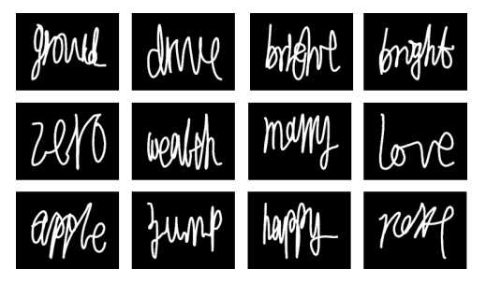
Experiments |Text Recognition Experiment
Figure 5: Different Handwritings of GestureTeach (Right) and others (Left) [23].
Notes:
We noted the difference between blackboard writing and the GestureTeach method, which incorporates pen lifting and dropping movements to improve the writing experience. Therefore, we design two hand gestures, namely, the pendown and pen-up gestures, based on the principles of real-world handwriting. As shown in Figure , previous works on trajectory capture and recognition[23][24] did not consider the control of pen lifting and dropping gestures, resulting in unnecessary trajectories that could interfere with the machine and user perception of the written content contrast to ours.

Slide 10
Experiments | Animation Generation Experiment
Figure 6: Generated Image Animatimation.
Notes:
For image animation generation, we utilized Stable Diffusion 1.5 as the base model and obtained 500K scribble-image pairs from the internet. We trained a modified Stable Diffusion Encoder and Decoder architecture with a combination of adversarial and mean squared error loss. To increase the diversity of the training data, we employed data augmentation techniques such as random rotation, scaling, and flipping, and implemented an early stopping strategy to prevent overfitting.

Slide 11
Experiments | Qualitative Results
Figure 7: The subjective ratings on handwriting in GestureTeach.
Notes:
We firstly gave a brief interview, asking the participants’ demographic information and their prior experience with online teaching. An experimenter then introduced the concept of GestureTeach and the tasks in this study. Then teachers were shown the functions of GestureTeach and corresponding gestures, which they also try to learn to master in the meantime. This learning process lasted about an hour until all the teachers thought they had mastered all the functions. Teachers were also asked to handwrite using other two widely-used online teaching approaches with Tencent-Meeting and PPT. After the whole first day evaluation, teachers were asked to fill out a questionnaire with three items on 7-point Likert scale about quality of the manuscript in three approaches.

Slide 12
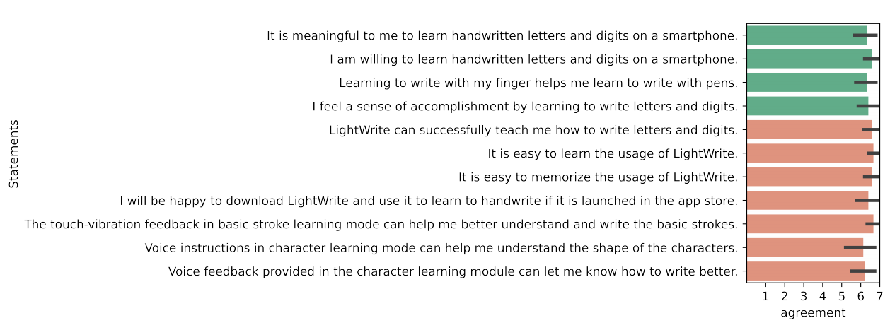
Experiments | Qualitative Results
Figure 8: The subjective ratings of ten gesture interaction techniques in GestureTeach.
Notes:
From our observations, teachers can be proficient with the system after around ten minutes
of practicing and successfully complete online courses after a five-day practicing stage. The results of the teachers’ questionnaire showed in Figure 7 indicated that teachers generally recognize the performance of handwriting in GestureTeach contrast to TencentMeeting and whiteboard pencil solution. Figure 8 showed that teachers appreciated the interaction techniques in online teaching and felt that the interaction techniques were fun to use and easy to learn. As for the students’ questionnaire, all students gave very positive ratings towards the idea of learning online through GestureTeach. Although not even asked by the experimenter, two teachers ex-pressed their strong interesting continuing to use GestureTeach after the study

Slide 13
Conclusion
In conclusion, this paper introduces a new pedagogical paradigm that enables free handwriting interaction and animation generation for online teaching.
To deal with challenges such as limited interactivity and display options, we propose a novel pedagogical paradigm and the corresponding technology that offers free handwriting interaction and two kinds of animation generation methods without the hardware facilities, making it a versatile solution for various online teaching scenarios.
We design a rapid multi-stage pipeline eliminating the requirement to locate the hand during the hand-tracking process, resulting in fewer redundant calculations and enabling highly freeform handwriting.
We introduce a novel gesture-recognitionbased animation generation technique that leverages handtips trajectories to enable teachers to freely handwrite and generate animation during online teaching.
Experiments validate the superiority of our proposed method over the state-of-the-art methods.
Notes:
In this paper, we introduce GestureTeach, a low-cost and accessible system designed to assist teachers in creating high-quality animations through handwriting. Our proposed interaction system includes free interaction channels and intelligent display options, all tailored to the needs of online teaching. Given user sketches, GestureTeach allows teachers to generate realistic animations through user-friendly pre-designed gestures, offering a high degree of freedom and creative interaction intention expression method. In our long-term usability evaluation study, GestureTeach received overwhelmingly positive feedback from participants. Our work highlights the potential of using gestures as a means of facilitating online teaching, and we hope to inspire other researchers to explore the use of gestures and other interactive methods in assisting teachers in online education.

Slide 14
Thanks for Listening!

