Slide 1
Greek island of Rhodes
June 04-10, 2023
SigVIC: Spatial Importance Guided Variable-Rate
Image Compression
Jiaming Liang¹, Meiqin Liu¹, Chao Yao², Chunyu Lin¹, Yao Zhao¹
¹Institude of Information Science, Beijing Jiaotong University, Beijing, 100044, China
²School of Computer and Communication Engineering, University of Science and Technology Beijing, Beijing, 100083, China
Notes:
Hello everyone, in this work, we propose a spatial importance guided variable-rate image compression, SigVIC.

Slide 2
Contents
01
Introduction
02
Proposed Method
03
Experiments
04
Conclusion
Notes:
In the following sections, we will introduce our method from the following aspects.

Slide 3
Contents
01
Introduction
02
Proposed Method
03
Experiments
04
Conclusion
Notes:
First, introduction.

Slide 4
01
Introduction
Learned Image Compression
Non-Variable-Rate
Variable-Rate
$${model}_{1}$$
$${Bitrate}_{1}$$
$${model}_{2}$$
$${Bitrate}_{2}$$
$${model}_{3}$$
$${Bitrate}_{3}$$
$${model}_{vr}$$
$${model}_{4}$$
$${Bitrate}_{4}$$
···
···
$${model}_{n}$$
$${Bitrate}_{n}$$
Flexibility
Training Costs
Model Storage
Notes:
Learned image compression has made rapid progress and achieves excellent RD performance.
However, these methods usually require training separate models for each bitrate, which is inflexible. Furthermore, as the number of required bitrates increases, the training cost and model storage also increase proportionally.
In contrast, the variable-rate mechanism allows a single model to adapt to multiple bitrates, which can enhance the flexibility of compression methods while reducing time and space costs, and is more suitable for real-world application scenarios.

Slide 5
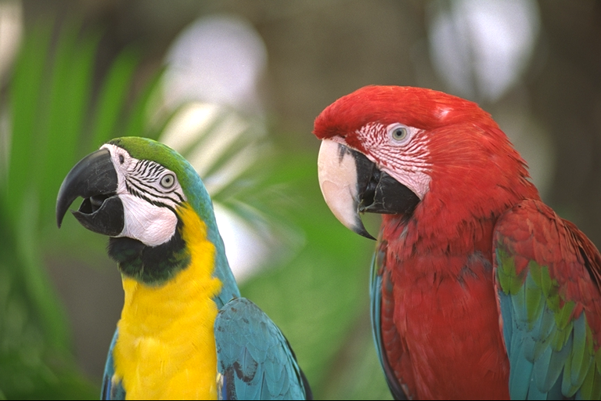
01
Introduction
T
inv-T
Q|AE
AD
$$x$$
$$\hat{x}$$
Scaling
Network
$$λ_{ }$$
Scaling
Network
Notes:
A classic way to realize the variable-rate in learned image compression is to scale the features in network.

Slide 6
01
Introduction
T
High Quality&Bitrate
inv-T
Q|AE
AD
Low Quality&Bitrate
$$x$$
$$\hat{x}$$
Scaling
Network
$$λ_{large}$$
Scaling
Network
$$λ_{small}$$
Notes:
This method involves using neural networks to learn RD tradeoff and generate scale factors, which are then used to scale the features in network.
After quantization and arithmetic encoding, the resulting features with varying fineness correspond to the results at different bitrates and quality levels, thereby achieving variable-rate compression.

Slide 7
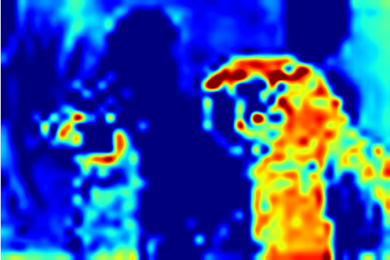
01
Introduction
T
inv-T
Q|AE
AD
Spatial Importance
and $λ_{ }$Related
$$x$$
$$\hat{x}$$
Spatial
Scaling
Network
Spatial
Scaling
Network
Scaling
Network
$$λ_{ }$$
Scaling
Network
$$spatial$$
$$importance$$
$$spatial$$
$$importance$$
Notes:
However, these methods primarily scale the features in the channel dimension, without considering the guidance of spatial importance differences in adjusting bit allocation.
In reality, different regions of an image possess different amounts of information and importance.
In scenarios where the available bitrate is limited, leveraging spatial importance to adjust the bit allocation of image compression can lead to more efficient bitrate control.
Therefore, we propose a spatial importance guided variable-rate image compression method.

Slide 8
Contents
01
Introduction
02
Proposed Method
03
Experiments
04
Conclusion

Slide 9
02
Proposed Method
Conv 5x5, N, s2,
GDN/IGDN
Top-K
D
$$x$$
C
$$y$$
Q
SSN
SSN
SSN
SSN
$$Λ=$$
$$\{λ_{i}⋯\}$$
AE
Entropy
Model
SSN
SSN
SSN
SSN
AD
Spatial Gating
Unit (SGU)
$$\hat{x}$$
SFFM
C
$$\hat{y}$$
Spatial Scaling
Network (SSN)
SSN
U
SFFM
Shallow Feature
Fusion Module
Notes:
Firstly, we designed a spatial gating unit to adaptively learn the spatial importance mask of the image.
Next, we designed a spatial scaling network that utilizes the learned mask to guide the feature scaling, enabling variable-rate compression.
Additionally, we incorporates a Top-K shallow feature fusion strategy to further refine the decoding features, improving the quality of decompressed image.

Slide 10
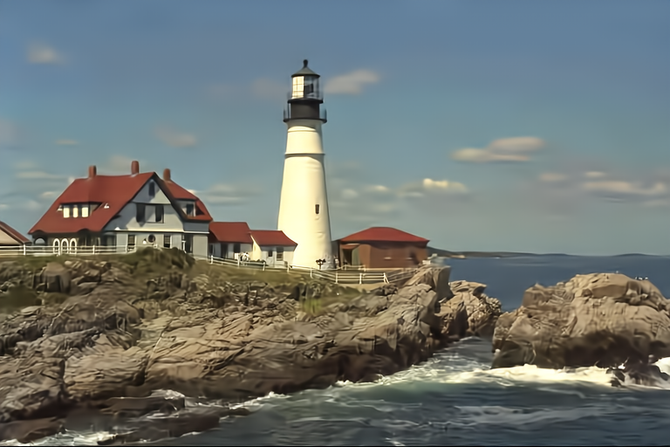
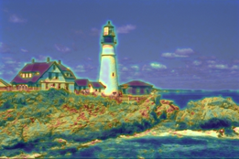
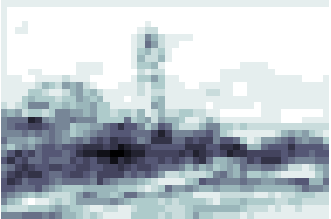
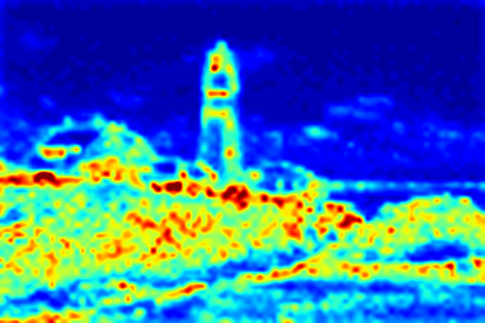
02
Proposed Method
Stage t
Feature Scaling
$$f_{g}^{t}$$
$$f_{s}^{t}$$
$$f_{ }^{t}$$
$${i_mask}_{ }^{t}$$
$${sf}_{ }^{t}$$
SSN
$$f_{g}^{t}$$
$$f_{s}^{t}$$
$$λ_{i}$$
Spatial Gating Unit (SGU)
Spatial Scaling Network (SSN)
$${i_mask}^{t}$$
Channel
Aggregate
$$f_{ }^{t}$$
Conv, 3x3
$$f_{g}^{t}$$
$$si_map$$
MLP
C
E
$${sf}^{t}$$
$$λ_{i}$$
Expand
$$λ_{i}$$
Conv, 3x3
Conv, 1x1
S
$${i_mask}^{t}$$
$$rd_map$$
Notes:
Let's take a look at the details of the modules.
The SGU is utilized to adaptively generate spatial importance mask of image features, which is used to filter out unimportant information in features and play the role of gating.
This mask also serves as one of the conditions for spatially guiding the RD optimization.
Then, the SSN employs the RD tradeoffs and spatial importance mask as joint conditions to generate spatial scale factors.
By multiplying with the features in network, the spatial bit allocation is adjusted and the spatial importance guided variable-rate is realized.

Slide 11
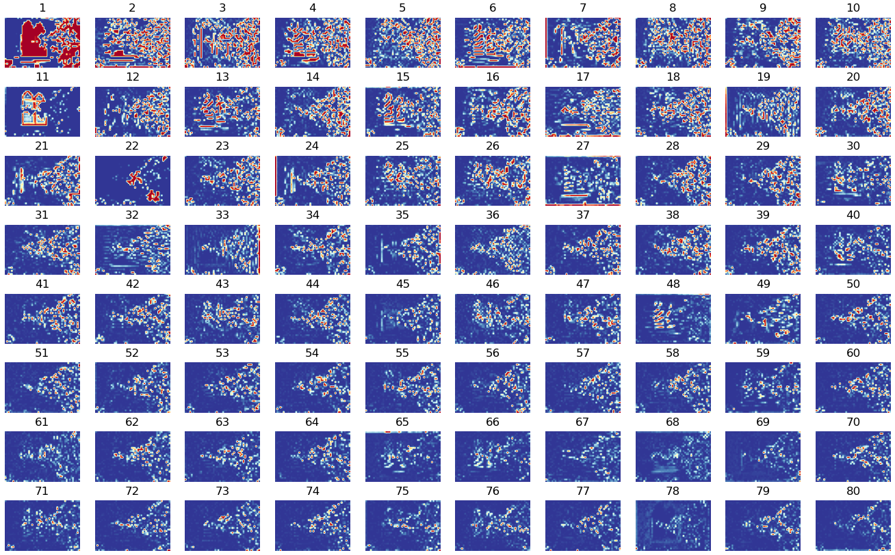
02
Proposed Method
Top-K
D
Conv 5x5, N, s2,
GDN/IGDN
$$x$$
C
$$y$$
$$f_{ }^{t}$$
Q
SSN
SSN
SSN
SSN
$$Λ=$$
$$\{λ_{i}⋯\}$$
AE
Entropy
Model
SSN
SSN
SSN
SSN
AD
Spatial Gating
Unit (SGU)
$$\hat{x}$$
SFFM
C
$$\hat{y}$$
Spatial Scaling
Network (SSN)
SSN
U
SFFM
Shallow Feature
Fusion Module
Notes:
We attempt to leverage shallow features to enrich the information of decoding features.
Considering that most of the information is only provided by a few channels in features, we select top K channels of shallow features to balance the performance and computation, which contain the most abundant information.

Slide 12
02
Proposed Method
Top-K
D
Conv 5x5, N, s2,
GDN/IGDN
$$x$$
C
$$y$$
Shallow Feature Fusion Module (SFFM)
RCAB
RCAB
Conv
$$\hat{x}$$
Q
$$f_{ }^{ }$$
SSN
SSN
C
SSN
SSN
$$Λ=$$
$$\{λ_{i}⋯\}$$
AE
MP, s2
RCAB
RCAB
SC, s2
Entropy
Model
C
SSN
SSN
SSN
SSN
MP, s2
RCAB
SC, s2
MP: max pooling
SC: sub-pixel conv
AD
×4
Spatial Gating
Unit (SGU)
$$\hat{x}$$
SFFM
$$f_{ }^{ }$$
C
$$\hat{y}$$
Spatial Scaling
Network (SSN)
SSN
U
SFFM
Shallow Feature
Fusion Module
Notes:
Then, we design a SFFM to refine the decoding features using shallow features.
SFFM is a U-shaped network that leverages Residual Channel Attention Blocks (RCAB) to effectively fuse features from multiple scales, fully refining the decoding features.

Slide 13
Contents
01
Introduction
02
Proposed Method
03
Experiments
04
Conclusion
Notes:
Now, we show some experimental results.

Slide 14
03
Experiments
Settings | Contents
Training Set | 13600 images randomly cropped to 256*256 from ImageNet dataset
Test Set | Kodak dataset and CLIC professional validation dataset
Distortion Metric | PSNR and MS-SSIM for distortion
Training settings | batch size=8, iterations=2M, learning rate=1e-4 (1e-5 for last 0.1M iters)
Loss Function：
$$L=R\left(\hat{y}, \hat{z},λ_{i}\right)+λ_{i}D\left(x,\hat{x},λ_{i}\right) \left(λ_{i}∈Λ\right)$$
where $Λ=$ (0.0016, 0.045) for MSE-Loss and (5, 120) for MS-SSIM-Loss
Notes:
In the experiment, we randomly select 13600 images from the ImageNet dataset and crop them to the resolution of 256.
The Kodak and CLIC datasets were used as test sets, the PSNR and MS-SSIM are used as distortion metrics.
To adapt to any variable bitrate, we designed the loss function as follows.

Slide 15
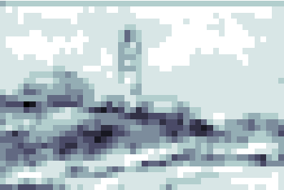
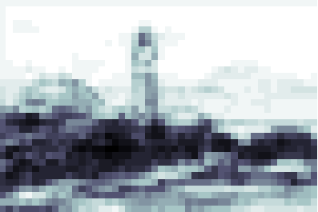
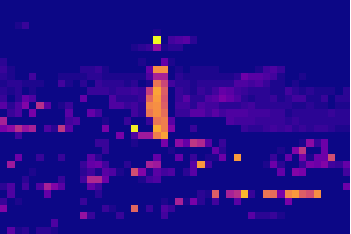
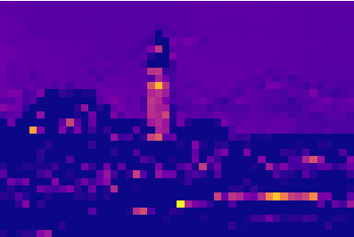
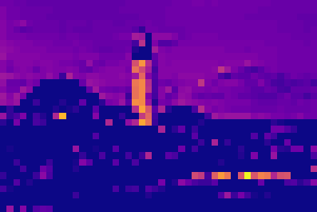
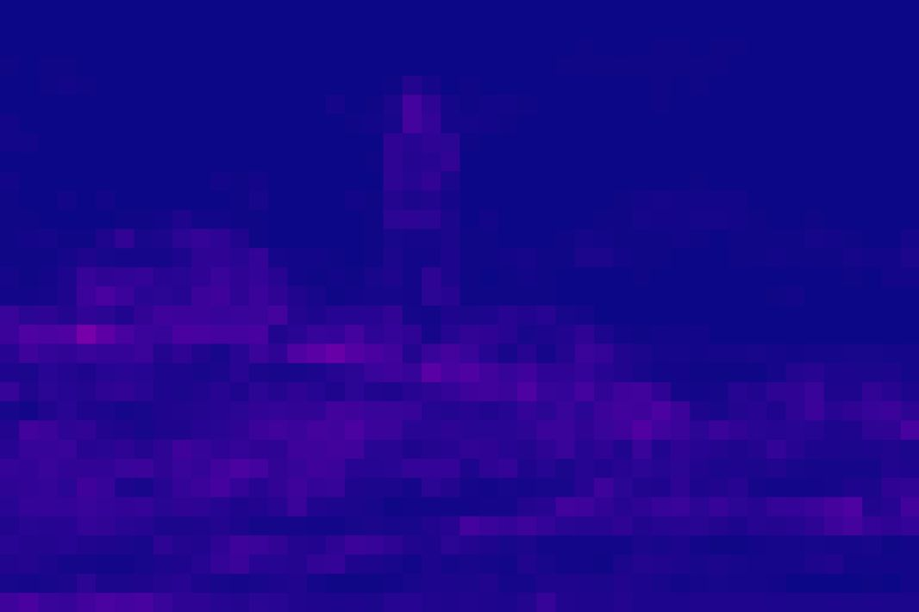
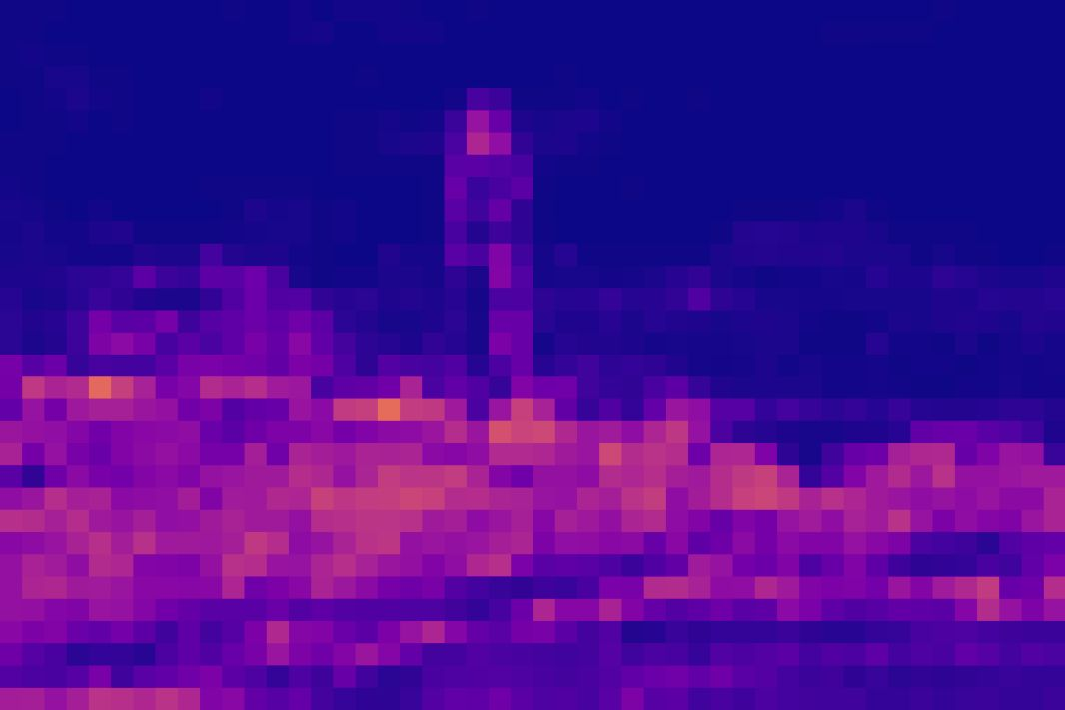
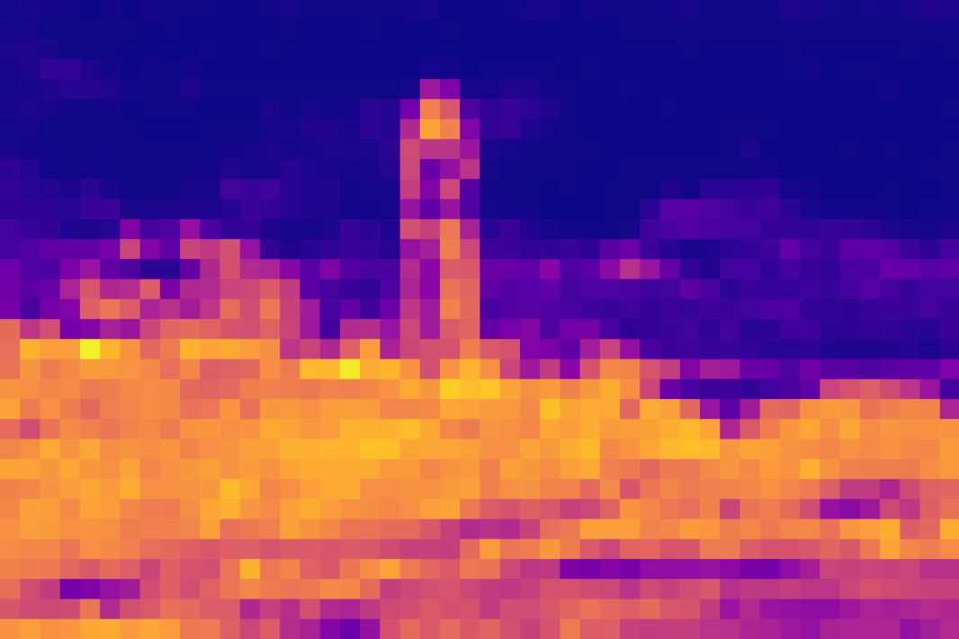
03
Experiments
Spatial Importance Guided (Ours)
Uniform Quality Map
Scale Factor
Bit Allocation
low
Quality Levels
high
low
Quality Levels
high
Notes:
To evaluate the effectiveness of our proposed spatial importance guided feature scaling and bit allocation, we visualize the scale factors along with the corresponding bit allocations at different levels of RD tradeoff.
It can be seen that, the scale factors of our method have learned the spatial importance of image and scale the features of various regions with varying weights.
In contrast, the uniform quality maps use equal weights to scale different regions.
As a result, our method allocates more bits to the informative regions under the guidance of spatial importance.
When the bitrate is constrained, our method can achieve more efficient bitrate control and better compression performance.

Slide 16
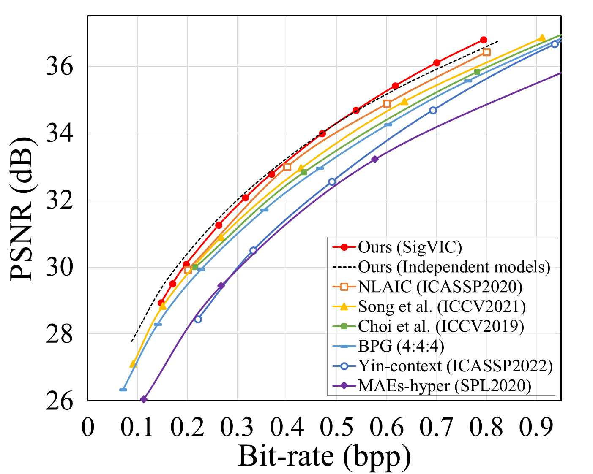
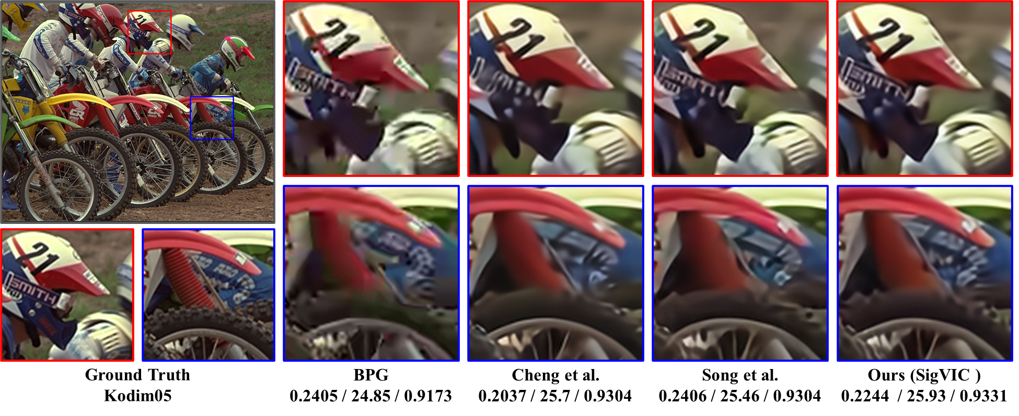
03
Experiments
Notes:
This is the RD results in terms of PSNR on Kodak dataset, obviously, our method demonstrates the superior RD performance.
Besides, the variable-rate model achieves comparable performance to 6 independent models, suggesting that our variable-rate mechanism will not affect the RD performance of compression methods.
These are the reconstructed images, ablation study, and complexity analysis, respectively. It can be seen that our method restores more details, offers advantages in terms of complexity, while each contribution improves the performance.

Slide 17
Contents
01
Introduction
02
Proposed Method
03
Experiments
04
Conclusion
Notes:
Finally, we summarize our work.

Slide 18
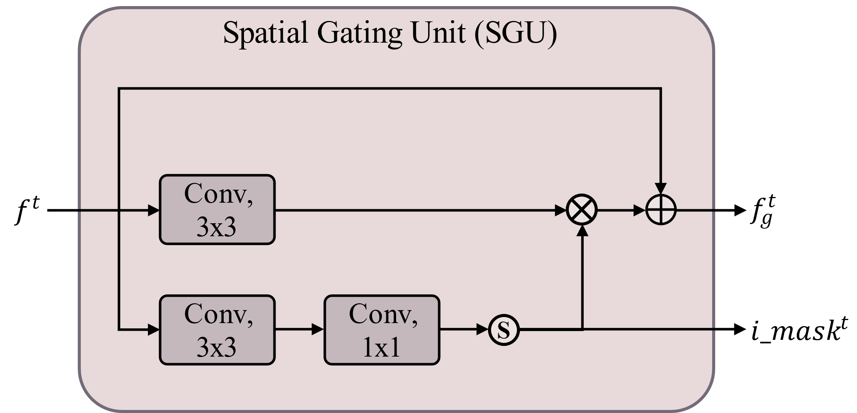
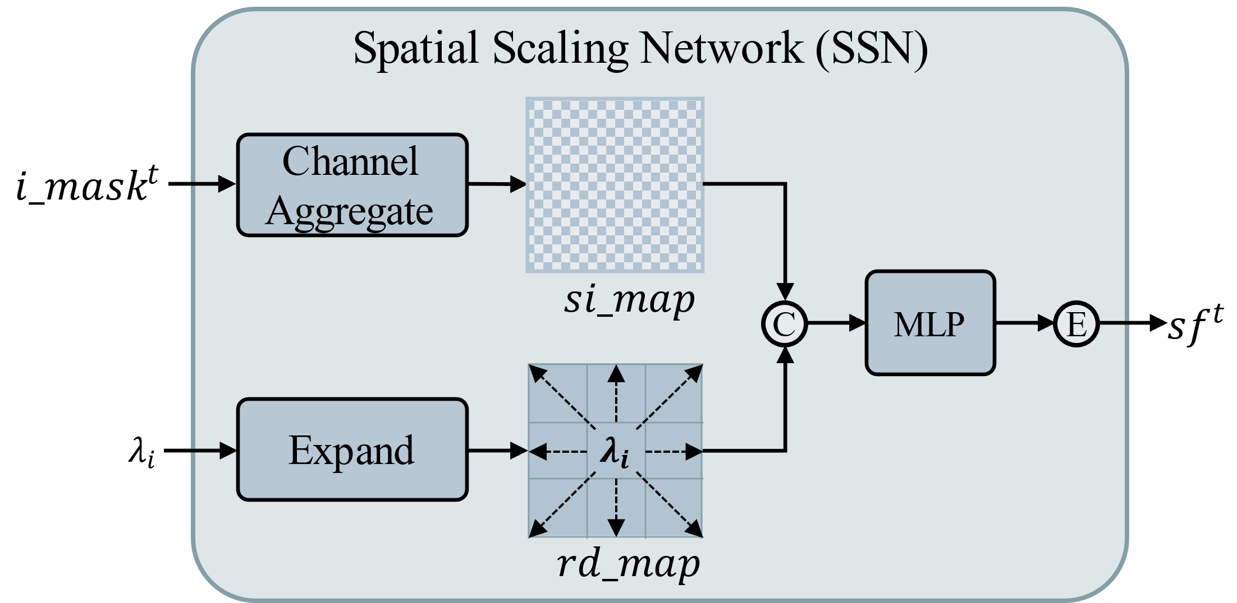
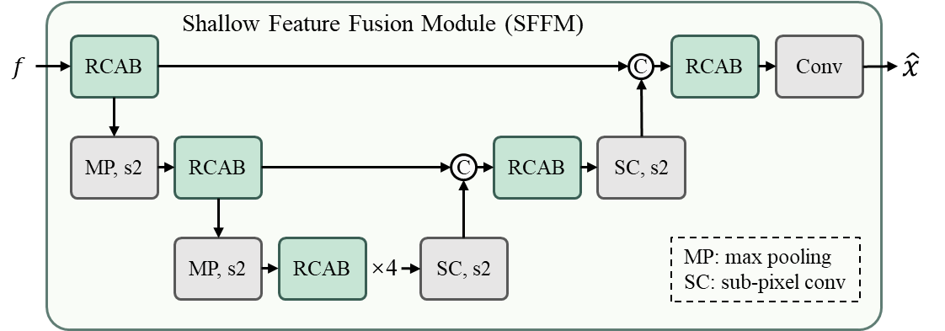
04
Conclusion
Spatial Gating
Unit
Spatial Scaling Network
Shallow Feature Fusion Module
To adaptively learn the spatial importance of image
Use spatial importance
to guide the RD optimization
Leverage shallow features to refine decompressed image
Experimental results efficient spatial-differently variable-rate mechanism & excellent RD performance
Notes:
To realize spatial importance guided variable-rate compression, we first design a spatial gating unit to adaptively learn the spatial importance mask of image. Next, we design a spatial scaling network to guide the RD optimization using the spatial importance mask. Through a series of experiments, the proposed method achieves an efficient variable-rate mechanism and excellent RD performance.

Slide 19
Greek island of Rhodes
June 04-10, 2023
Thanks for Listening
Notes:
Thank you for your attention!

